Slide 1

NEWS TEXT SANITIZATION
BY GROUP 3

Slide 2
News text sanitization using regex and tf-idf vectorization with naive Bayes.
• This presentation will cover the process of sanitizing news text using regex and tf-idf vectorization, and how naive Bayes can be applied for classification.
• The goal is to achieve accurate classification of news articles to assist in automated news categorization.

Slide 3
WHAT IS NEWS TEXT SANITIZATION
The technique of clearing unneeded or extraneous material from news items is known as "news text sanitization.“
The removal of HTML elements, punctuation, stop words, and numerals is one of the sanitization strategies.
A clean dataset must be produced in order to do further analysis.

Slide 4
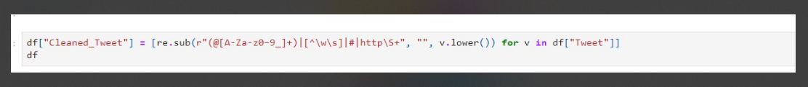
WHAT IS REGEX?
Regular expression, or regex, is a sequence of characters that defines a search pattern.
• It is used to match and manipulate strings of text, such as news articles.
• Regex is useful for sanitizing text by identifying and removing unwanted patterns.

Slide 5
WHAT IS NAVIE BAYES ?
Naive Bayes is a widely used classification algorithm in NLP.
That determines the likelihood of a class given a set of data and makes the assumption that features are independent of one another.
Text categorization tasks tend to use Naive Bayes.

Slide 6

HOW DOES TF-IDF VECTORIZATION WORK?
Term Frequency-Inverse Document Frequency (TF-IDF) is a numerical statistic that reflects the relevance of a word in a document.
It is calculated by multiplying the frequency of a word in a document by the inverse frequency of the word in the entire dataset.
TF-IDF vectorization converts text data into a numerical format that can be used for text classification and sentiment analysis in NLP.

Slide 7

THE EVALUATION OF MODEL PERFORMANCE
Metrics like accuracy, precision, recall, and F1 score can be used to assess the model performance.
The effectiveness of the algorithm's extension may be evaluated via cross-validation.
To improve the accuracy of the model, hyperparameter tuning can be applied.

Slide 8
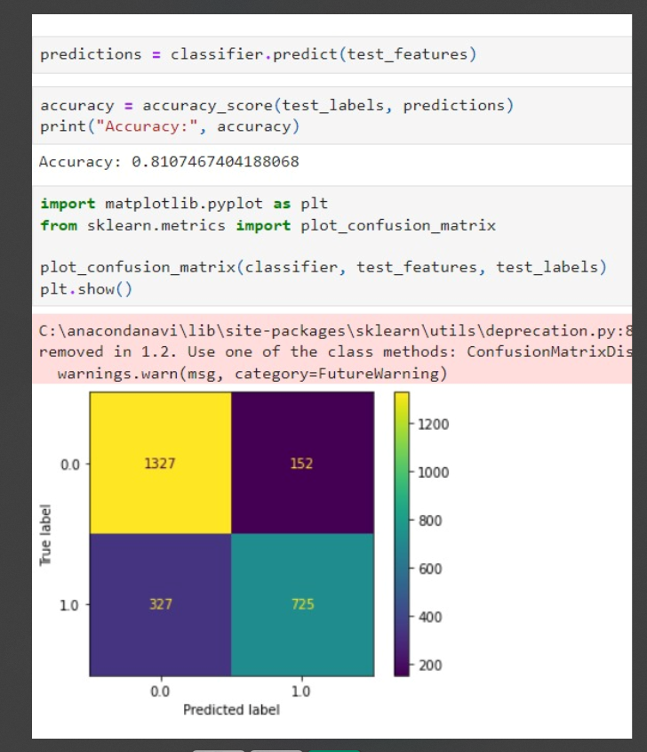
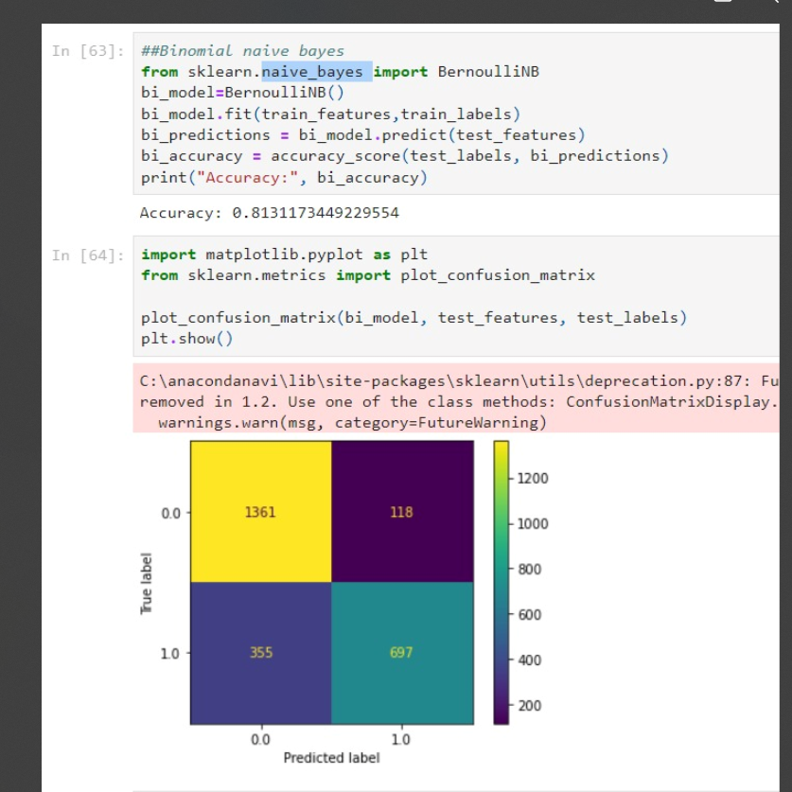
COMPARING OUTPUTS USING REGRESSION TECHNIQUES

Slide 9

Stay Tuned In Progress
Still Model tuning is in progress to increase the accuracy of the model and predict the tweet more accurately.
Link to the dashboard Git:
https://github.com/Sudkart/DS_ProjectManagement
Thank You

